Slide 1
Practical web development basics
HTML
CSS
PHP
REST
javascript
Node
Angular
ORM
?!
Prepared by Nitish Patkar

Slide 2
Major milestones in web development
1993
HTML
1995
Javascript
1996
CSS & Flash
2005
Ajax
2006
jQuery & Amazon Web Services
2010
AngularJs
2011
Bootstrap
2013
React
2016
Angular 2+

Slide 3


As a web developer you cannot live without..

Slide 4
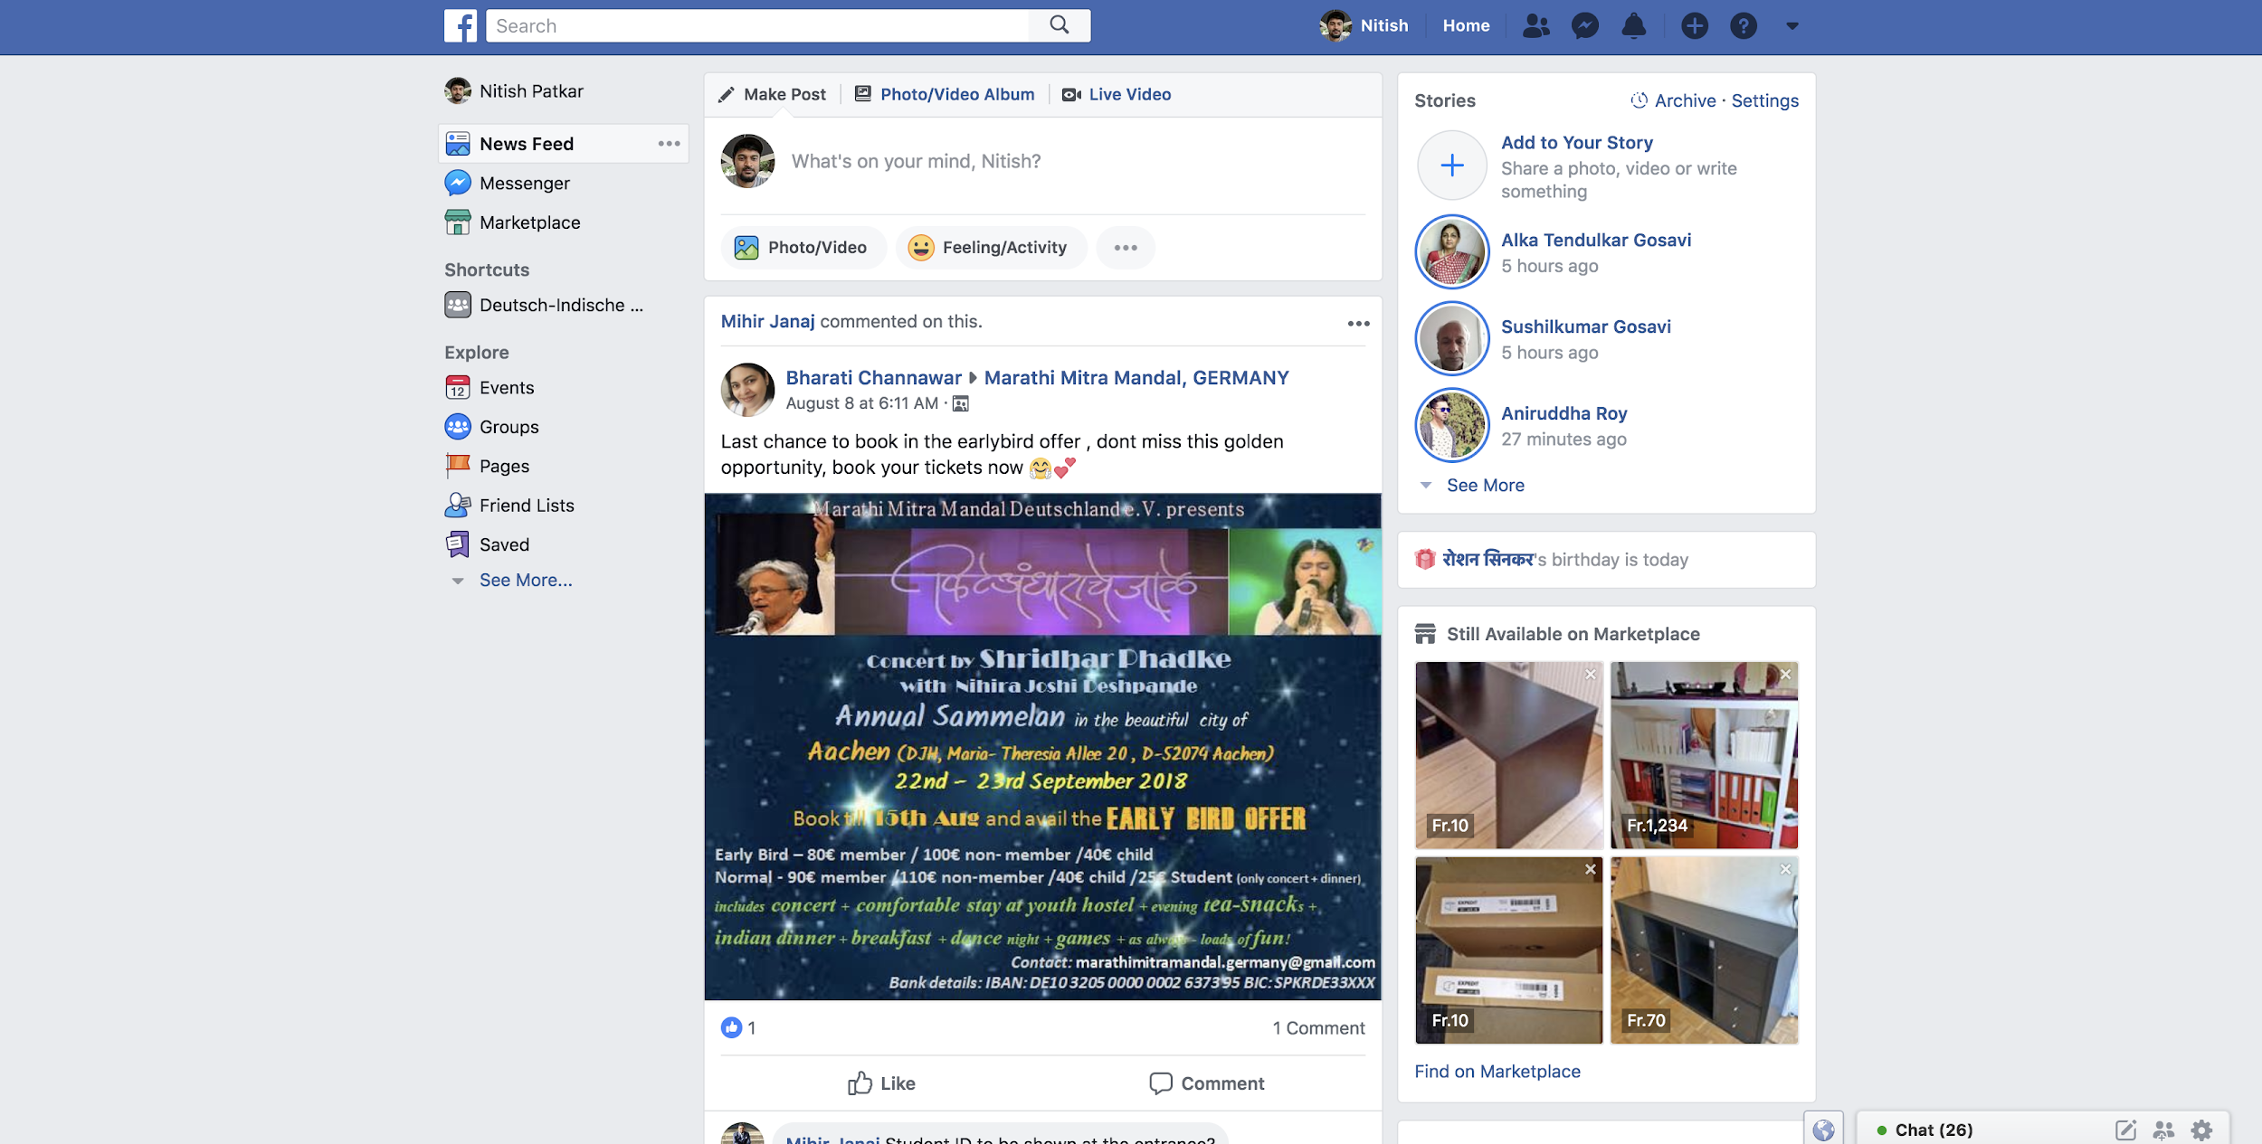
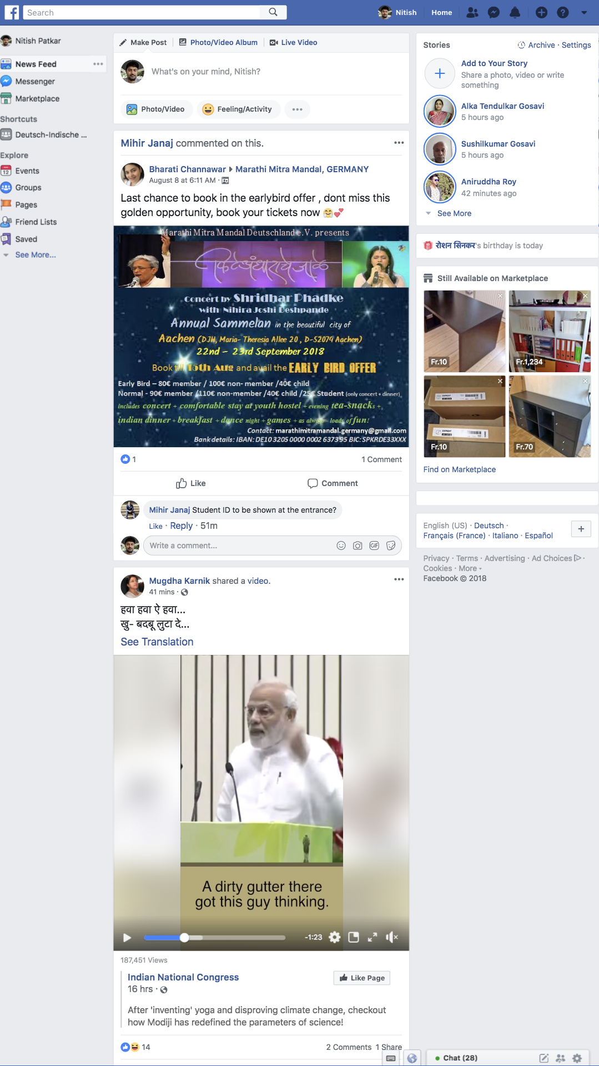
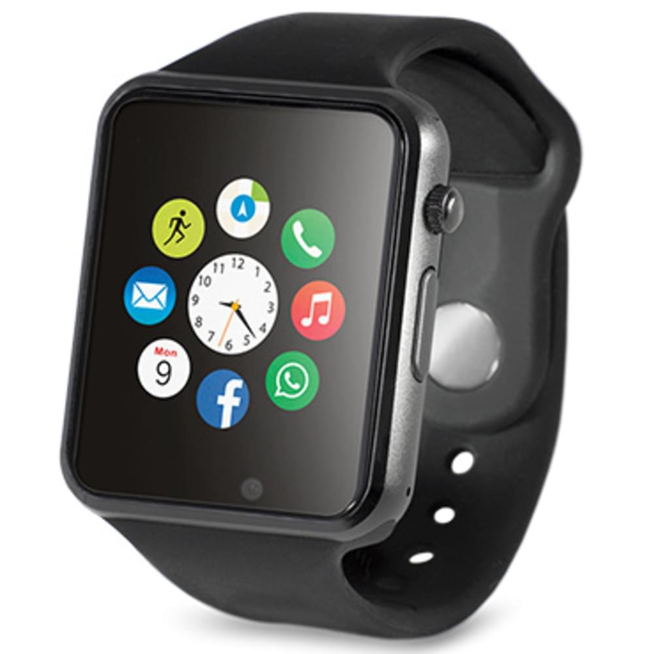
Simplified view on today's web development
HTTP request
HTTP response
Database
backend
Various frontends

Slide 5
Frontend: key responsibilities and main concepts to get familiar with
It is what your users see- can be accessed on mobile as an app, or as a mobile website, or on laptops etc.
Accepts request from users and forwards it to the backend, subsequently receives response from backend and shows it to the user
Main concepts to get familiar with-
HTML, CSS, Javascript, Typescript
HTTP requests
Ajax (or asynchronous calls to backend)
Javascript frameworks and libraries (e.g. Angular, React, Vue.js )
Styling frameworks (e.g. Bootstrap, Material)
Package manager (e.g. NPM)
Single Page Applications (SPAs)
Developer tool in browser for debugging
Responsive design
Browser compatibility
...
Various frontends

Slide 6
Backend: key responsibilities and main concepts to get familiar with
Handles business logic for your application- you write a single backend application which is typically consumed by various frontends
Coordinates with frontend and database
Main concepts to get familiar with-
REST API
JSON data format
Programming languages (e.g. PHP, Python, Java)
Backend frameworks (e.g. Django Rest, .NET core, Ruby on Rails)
Object Relational Mapping (ORM)
Request routing
Security concerns
Architecture (e.g. MVC, MVVM)
Session management
backend

Slide 7
Database: key responsibilities and main concepts to get familiar with
Stores user and application data
With the availability of ORMs, developers deal less and less with databases directly, but it is still good to know
Main concepts to get familiar with-
Types of databases (e.g. Relational, non-relational)
Database backups
Database query languages (e.g. SQL)
Scripting languages (e.g. PL/SQL)
Database

Slide 8
Frameworks
One can do web development without frameworks, but using them simplifies many routine tasks and speeds up the development, also makes sure applications are scalable
Choosing a correct framework depends on multiple factors such as programming language preference, framework documentation, community support etc.
There are different frameworks for frontend development, backend development, and also for styling

Slide 9




Frontend (javascript) frameworks
Enforces developers to write HTML, CSS and javascript in a certain way to make the application easier to develop and maintain
Easy handling of Ajax calls, HTTP requests
Most popular frontend frameworks and libraries:
Angular
Vue.js
React
Ember.js

Slide 10

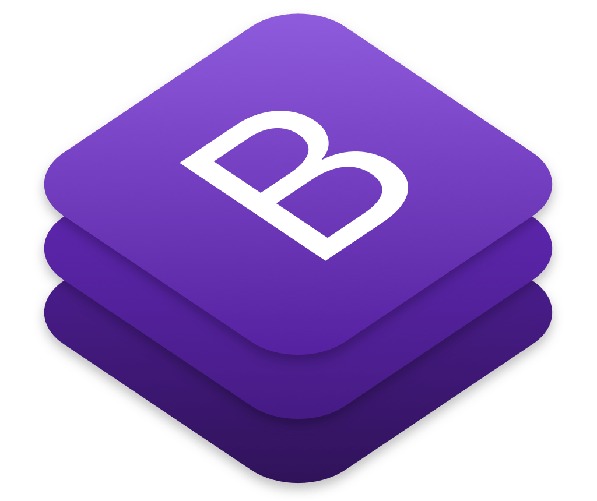


Styling (CSS) frameworks
Provides ready to use css classes, components and grid system based on proven design standards, so that developers do not have to write css from scratch
Most popular css frameworks:
Bootstrap
Semantic UI
Materialize
Material UI

Slide 11




Backend frameworks
They provide tools and libraries that simplify common web development tasks, including routing URLs to appropriate handlers, interacting with databases through ORM, supporting sessions and user authorization, formatting output (e.g. HTML, JSON, XML), and improving security against web attacks.
Most popular backend frameworks:
Ruby on Rails
Laravel
Flask

Slide 12
Languages: HTML, CSS, Javascript
Frameworks: Angular, React, Vue.js
Styling: bootstrap, Material UI, Saas
Concepts: HTTP requests, responsive design, asynchronous calls, SPAs, NPM
Languages: HTML, CSS, Javascript
Frameworks: Angular, React, Vue.js
Styling: bootstrap, Material UI, Saas
Concepts: HTTP requests, responsive design, asynchronous calls, SPAs, NPM
Languages: Python, Java, javascript,...
Frameworks: Django, .NET core, Laravel,...
Concepts: HTTP requests routing, REST API, ORM, token & session management, CSRF, ...
Languages: Python, Java, javascript,...
Frameworks: Django, .NET core, Laravel,...
Concepts: HTTP requests routing, REST API, ORM, token & session management, CSRF, ...
Types: Relational, NoSQL
Examples: MySQL, PostgreSQL, MongoDB,..
Types: Relational, NoSQL
Examples: MySQL, PostgreSQL, MongoDB,..
Database
backend
Various frontends

Slide 13


Project scaffolding
Helps to quickly set up a project skeleton (hopefully) with best practices
One can scaffold a project by using CLI tools such as angular cli for angular projects, or by cloning a repository from GitHub, gitlab etc.
Best known scaffolding tools:
Yeoman

Slide 14



Project management tools
Helps to organise development work within teams, manage user stories, deadlines, generate project analytics and many more tasks
Best known project management tools:

Slide 15

Communication tools
Helps to communicate with other team members through dedicated channels, direct messages and rich content such as video, images, Gif etc.
Provide search functionality and integrations to other applications such as confluence, gitlab etc.
Best known communication tool:

Slide 16
Latest buzzwords in web development
Agile
CI/CD pipeline
DevOps

Slide 17







Continuous Integration (CI)/Continuous Delivery (CD) pipeline and toolchain
Plan
Code
Build
Test
Release
Deploy
Other end to end solutions

